Slide 1


NYC Business Licenses
Patterns, Gaps & Opportunities for Smarter Policy & Enforcement
Team #8
Ronak Pipaliya
Sajan Shergill
Darpan Gorasiya

Slide 2
Importance of Business Licenses
Unlocking Economic Insights
Understanding the high volume of business licenses in NYC reveals critical economic insights, supporting smarter city growth and enhancing decision-making for urban planning and resource allocation.
Enhancing City Operations
Business licenses are crucial for efficient inspections, compliance, and equitable policy application, directly impacting public safety and fostering a thriving economic environment in NYC.

Slide 3
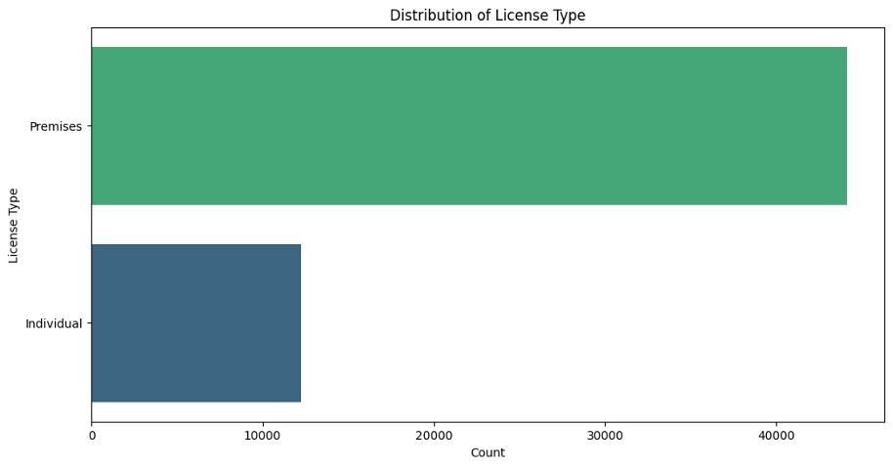
Data Distribution
NYC Business License Density

Slide 4
Core Research Questions
Investigate how the concentration and completeness of business license data reveal patterns in NYC’s economic and spatial structure.
Key Research Questions:
Where are licenses concentrated by Business Category?
2. Do certain license types cluster in specific neighborhoods?
3. How does missing latitude/longitude data vary by license type? What are the implications for data quality?
4. Can spatial imputation improve mapping accuracy for each license category?
→ Test how well neighborhood and ZIP-level trends help recover missing geolocations.

Slide 5
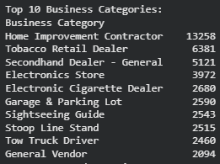
Top 10 Business Categories:
→ Compare the distribution of Premises Licenses (brick-and-mortar) vs. Individual Licenses (service professionals) across boroughs.

Slide 6
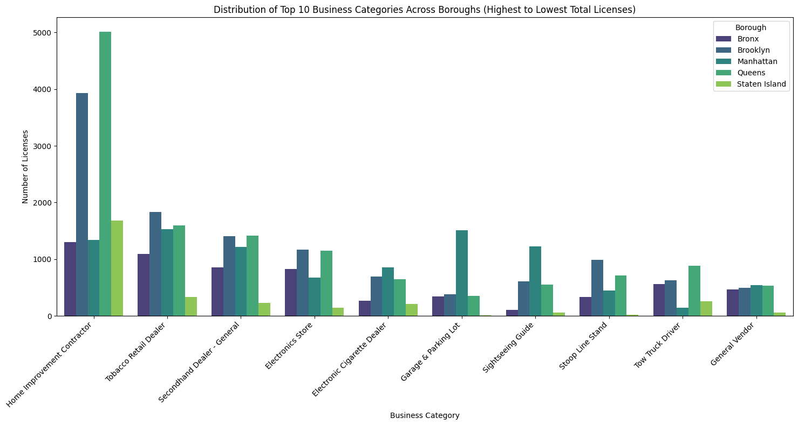
Where are licenses concentrated by Business Category?
→ Identify whether commercial areas (e.g., Midtown, Downtown Brooklyn) show higher premises density versus dispersed individual registrations.

Slide 7
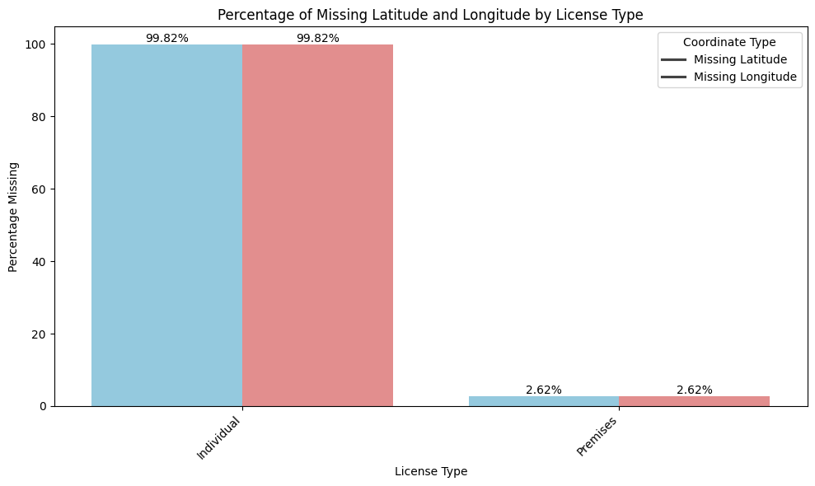
Why Missing Location Data Matters
Right now, 99% of individual licenses are invisible on the map.
We can map storefronts — we can’t map individual licenses
What this means:
We can reliably map and monitor storefront businesses
We can not locate individual business operators
This limits DCWP’s ability to:
- Plan inspections
- Detect unlicensed hotspots
- Enforce rules fairly
Fixing this requires better address collection during licensing

Slide 8

License Categories
Physical locations and premises
Understanding the differences between premises and individual business licenses is crucial for effective policy-making and compliance tracking in NYC's diverse business landscape.
Subject to local regulations and inspections
Individual operators and mobile licenses

Slide 9
Records Analysed
Our data comprises of over 66,000 records from various boroughs in NYC, capturing essential fields such as business type, location, dates, and status to facilitate comprehensive analysis and insights.

Slide 10

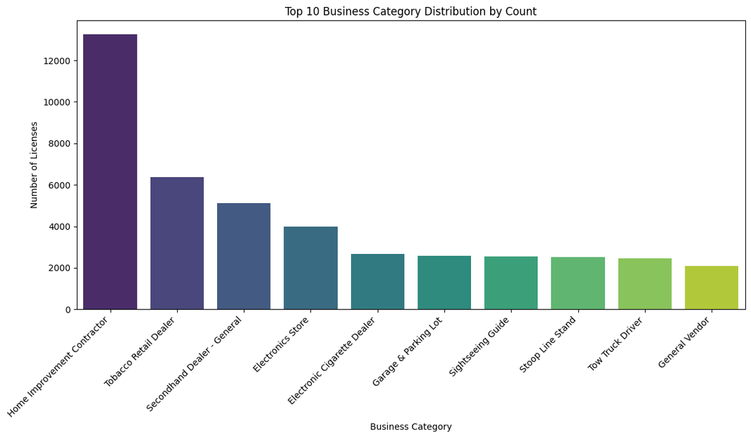
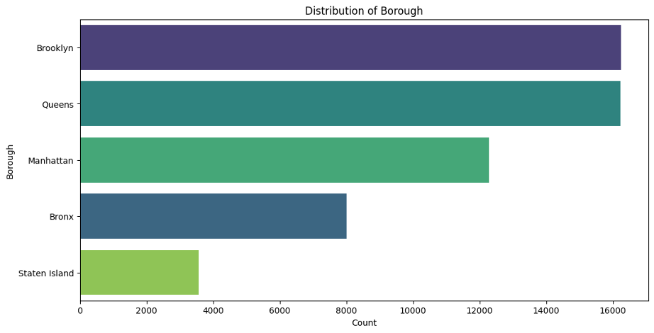
What the NYC Licensing Landscape Looks Like
Top 10 Licensed Business Types
(72% of all licenses)
Where These Businesses Are Located
(by borough)
Targeting the top 10 business types gives ~70% coverage
Borough-level clustering helps DCWP focus inspection routes

Slide 11
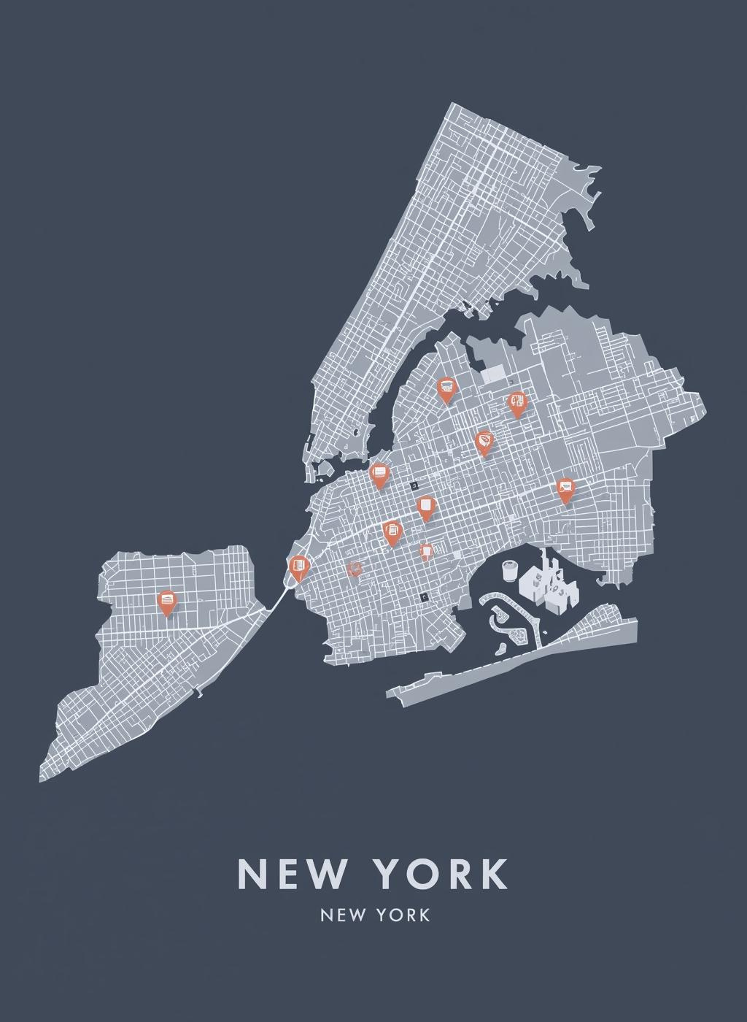
Location Prediction Insights
Estimating Missing Coordinates in NYC
By analyzing neighborhood and ZIP patterns, we can estimate missing coordinates, achieving an accuracy range of 3–4 km. This enhances our ability to visualize business locations across the city.

Slide 12
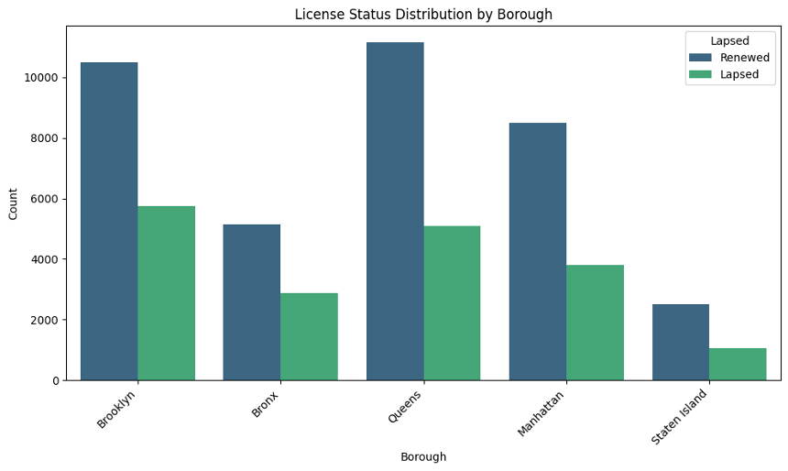

Renewal Rates by Borough
Analyzing License Trends
This section reveals significant differences in licensing trends and their implications for local businesses and economic health.
Understanding these correlations can improve city planning
and resource allocation strategies.

Slide 13
Enforcement Implications of Geographic Patterns
Insights for Effective Strategies
Understanding the geographic distribution of licenses informs targeted enforcement strategies. Focused inspections in high-density areas enhance compliance and operational efficiency for city regulators.

Slide 14
What the Data Tells Us About NYC Businesses
Key Insights
Industry Clusters
License Duration
Geo Information Predictability
The analysis reveals significant industry clusters throughout NYC, highlighting areas with high concentrations of specific businesses, which can inform targeted economic development strategies and resource allocation.
The higher the license duration, the higher the probability of renewal rate of that particular business. This reveals insights into business stability and potential growth areas across different boroughs.
Because we can predict locations well using neighborhood and ZIP code information, we can fill in missing address details more accurately. This improved location data then helps a lot with planning cities and making important policy decisions.

Slide 15
Key Takeaways and Conclusion
Leveraging Data for Improved Operations in the Department of Consumer and Worker Protection
Streamlined inspection routing for efficient resource allocation
Targeted renewal outreach based on predictive analytics
Enhancing neighborhood equity through data-driven decision making
Implementing fraud detection mechanisms to ensure compliance

Slide 16

Thank You for Your Attention
Team #8: Data tells the city’s story.

